Slide 1


PR: Working with the Media

Slide 2
How Does Pitching a Story Work?
  Capture Your Story – First, a member of the NEDS team – or our PR partners at Slowey McManus Communications (SMC) will reach out to make sure you’re comfortable to tell your story to media.
  Craft Pitch – Then, SMC crafts a “pitch” highlighting your story and why they think a news outlet should cover it and sends it to the appropriate targets.
  We Wait & Follow-up – If a news outlet is interested, they let us know and we coordinate an interview between you and the reporter. That said, timely angles (such as holidays, current events, etc.) alway help and SMC is persistent with follow-up pitches.
  IMPORTANT: Often times the news outlet wants to move quickly, especially in TV, because they have tight deadlines. When we reach out asking if you are willing to tell your story, be sure to tell us anything that might affect your availability in the upcoming weeks such as work, vacations, etc.

Slide 3
General Interview Techniques
  Have an idea of what you want to say ahead of time but don’t formulate answers. You’ll sound too scripted!
  Try to remain concise and conversational. However, you’re there to tell YOUR story and all the emotions that come along with it.
  Feel free to have a conversation with the reporter ahead of time. “What kind of questions do you think you’ll ask me?”
  If you need a second to formulate an answer, take it! Most of the time you are NOT live, so they will cut out any silence or pauses.

Slide 4
Phone Interview Techniques
  It’s best to stand up when you’re on the phone with a reporter for an interview. You’ll sound more engaged.
  Don’t put the phone on speaker. It can affect how it sounds to the reporter!
  Remember: despite it feeling like just a conversation, you’re still interviewing with a reporter who is most likely recording it!

Slide 5
TV Interview Techniques
  Dress the part
    Light colors are best. Avoid stripes, busy designs, and the color black.
  Body control – Be comfortable, confident, relaxed. Avoiding being stiff. If sitting, sit tall and avoid leaning back. If standing, place one foot slightly ahead of the other to avoid swaying.
  Unless it’s live, it’s okay to start your answer over again.
  Make eye contact with the reporter in person – not at the camera. If you have to look away at all, look down.
  Don’t be afraid to talk with your hands if that’s what you usually do. Just try and keep them below the chest so it's not too distracting.

Slide 6
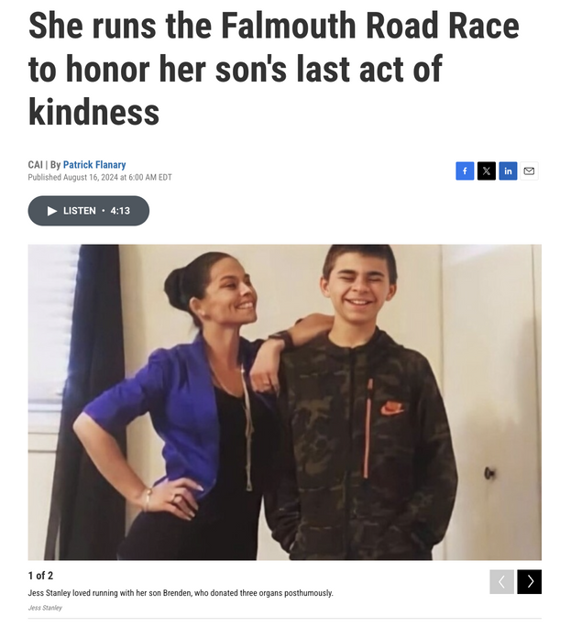
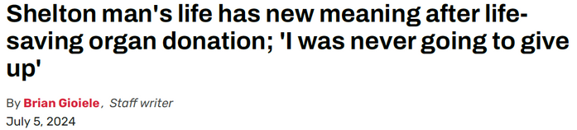
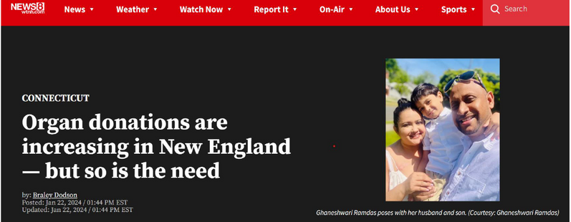
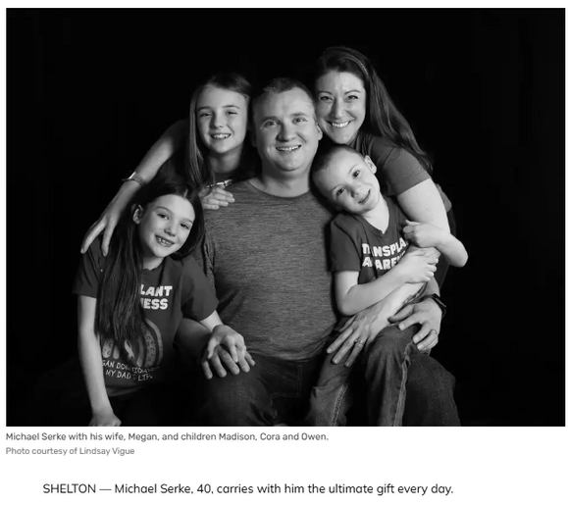
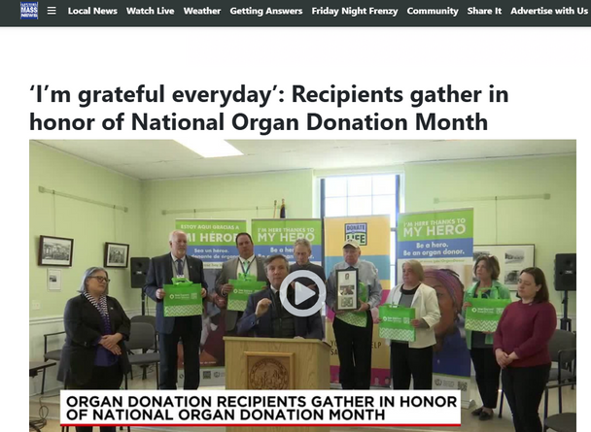

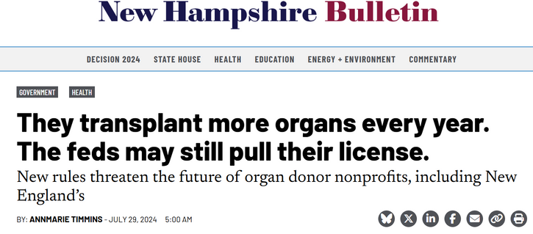
Recent Volunteer-Driven Stories

Slide 7
Questions? Or want to share your story?
Contact:
Marissa Johnson at Marissa_Johnson@neds.org
or
Jenn Cray at Jennifer_Cray@neds.org

